Slide 1



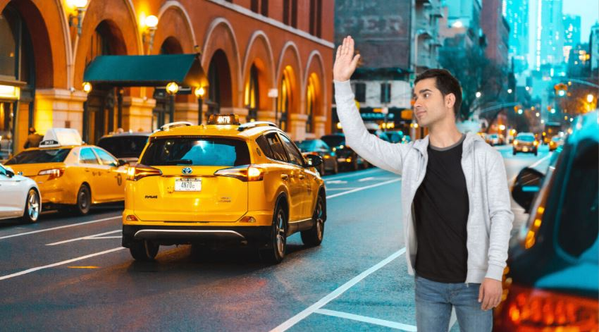
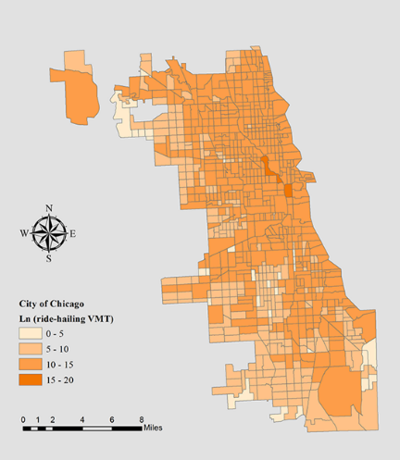
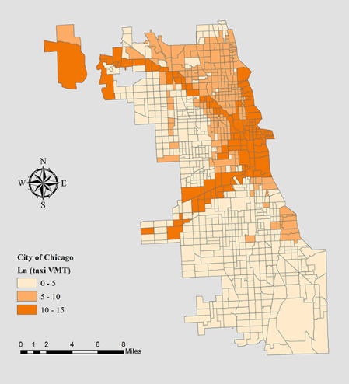
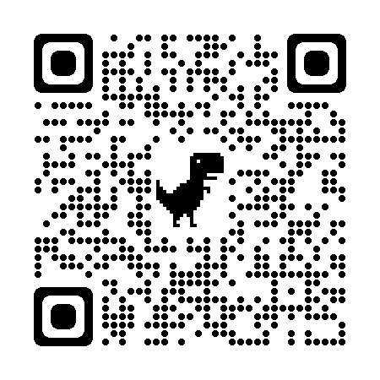
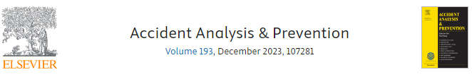
Poster session 2096
Poster number: TRBAM-24-00486
Assessing the Safety Performance of Ride-hailing Services and Taxis: A Multivariate Spatial Approach with Exposure Uncertainty
Guocong Zhai¹, Kun Xie^{1*}, Hong Yang¹, and Di Yang², * E-mail: kxie@odu.edu
¹ Old Dominion University (ODU), ² Morgan State University
Background
Data
Results & Discussions
Exposure Estimation
Variables | Severe ride-hailing crashes |  | Minor ride-hailing crashes |  | Severe taxi crashes |  | Minor taxi crashes
 | Mean | SD | Mean | SD | Mean | SD | Mean | SD
Intercept | -8.49* | 0.80 | -6.61* | 0.81 | -9.06* | 0.84 | -6.53* | 0.72
Transportation factors
Ln (VMT) | 0.30* | 0.05 | 0.22* | 0.05 | 0.31* | 0.05 | 0.29* | 0.05
Ln (mode-specific VMT) | 0.11* | 0.03 | 0.17* | 0.03 | 0.10* | 0.03 | 0.07* | 0.03
Traffic signal number | 0.02* | 0.01 | 0.02* | 0.01 | 0.02* | 0.01 | 0.03* | 0.01
Land use factors
Number of education sites | 0.12* | 0.04 | 0.08* | 0.04 | 0.08* | 0.04 | 0.09* | 0.04
Number of alcohol-related sites | 0.05* | 0.02 | 0.07* | 0.02 | 0.05* | 0.02 | 0.06* | 0.02
Demographic factors
Median household income | 0.08* | 0.03 | 0.05* | 0.03 | 0.10* | 0.03 | 0.10* | 0.03
Transit ratio | 1.30* | 0.52 | 1.08* | 0.45 | 1.09* | 0.52 | 1.06* | 0.44
Walk ratio | 0.84 | 0.82 | 1.38* | 0.65 | 3.38* | 0.73 | 1.90* | 0.66
Safer Mode?
Models | Crash types | Ln (mode-specific VMT) |  | T test p-value
 |  | Mean | SD
NB | Severe ride-hailing crashes | 0.14 | 0.06 | 0.30
 | Severe taxi crashes | 0.07 | 0.03
 | Minor ride-hailing crashes | 0.26 | 0.03 | < 0.01
 | Minor taxi crashes | 0.05 | 0.02
MVCAR | Severe ride-hailing crashes | 0.12 | 0.03 | 0.86
 | Severe taxi crashes | 0.11 | 0.03
 | Minor ride-hailing crashes | 0.16 | 0.03 | 0.03
 | Minor taxi crashes | 0.08 | 0.02
MVCARME | Severe ride-hailing crashes | 0.11 | 0.03 | 0.81
 | Severe taxi crashes | 0.10 | 0.03
 | Minor ride-hailing crashes | 0.17 | 0.03 | 0.02
 | Minor taxi crashes | 0.07 | 0.03
Challenges
Uncertainty of mode-specific exposures of ride-hailing services and taxis.
Spatial correlations across crash observations.
Inherent correlations among different types of crashes.
Objective
Assess the safety performance of ride-hailing services and taxis.
Mode-specific exposure estimation with classical measurement errors.
Multivariate spatial approach simultaneously capturing spatial and inherent correlations.
Methodology
Multivariate Conditional Autoregressive Model with Measurement Error (MVCARME)
Conclusions
Ride-hailing services are found to be prone to a higher risk of minor injury crashes compared with taxis, despite no significant difference between the risks of severe injury crashes
The full text is available in Accident Analysis & Prevention.
QR code::
K-dimensional multivariate normal distribution to capture spatial and inherent correlations
Acknowledgements
The work is partially funded by the Transportation Informatics Lab, Department of Civil and Environmental Engineering at Old Dominion University (ODU).
Gaussian distribution to identify measurement errors

